Slide 1

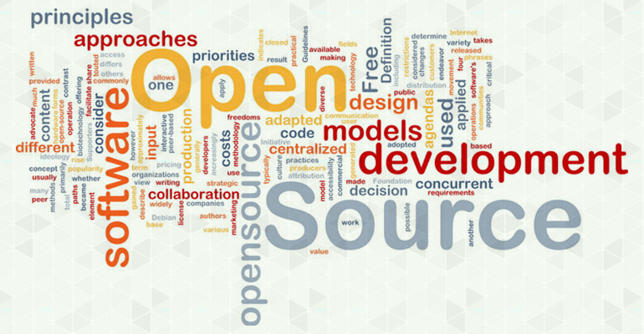

Open Source Technology Lab (OSTL)
Prof. B Thangaraju

Slide 2
OSTL – Strategic Plan
Purpose
To be Recognized as One of the Principal OSS Contributors in INDIA
Focus
Creation of and Contribution to OSS Projects
Publish in Conferences/Journals
Key Objectives
OSS Community Development
Support Open Source Through Active Contributions
Launch New Open Source Projects
Publish OSTL Newsletter
Active Participation in OSS Forum
Assist Faculty Members in Open Sourcing Research Project

Slide 3
Strategic Plan
Open Source Project Creation
Operating System
Kernel
Real Time
ROS
AGL
CELF
CGL
Container
Cloud Computing
DevOps
GitHub
GitHub Explore
Sourceforge.net
Collaboration with Existing Open Source Projects
Linux Kernel Mailing List
GitHub
GitHub Explore
Sourceforge.net
Publication
Open Source India Conference
Open Source For You Magazine
Academic Journals/Conferences

Slide 4
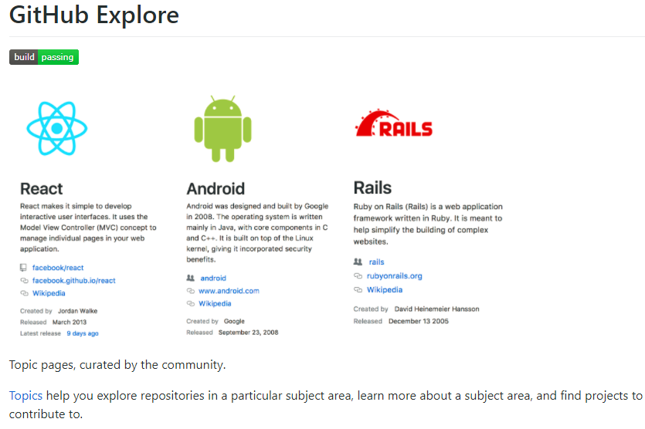
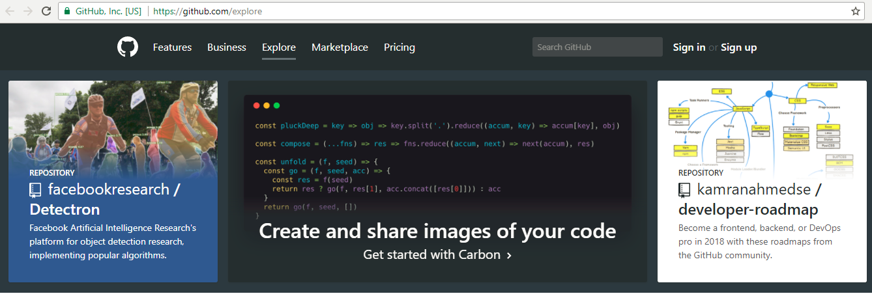
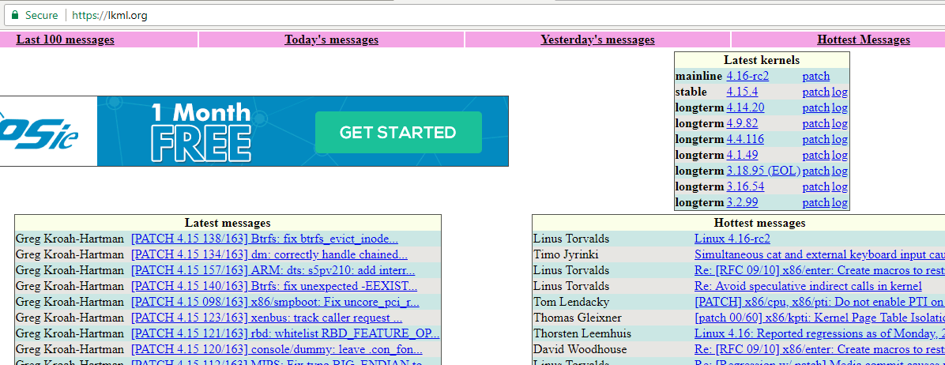
Collaborate with Existing Open Source Projects

Slide 5
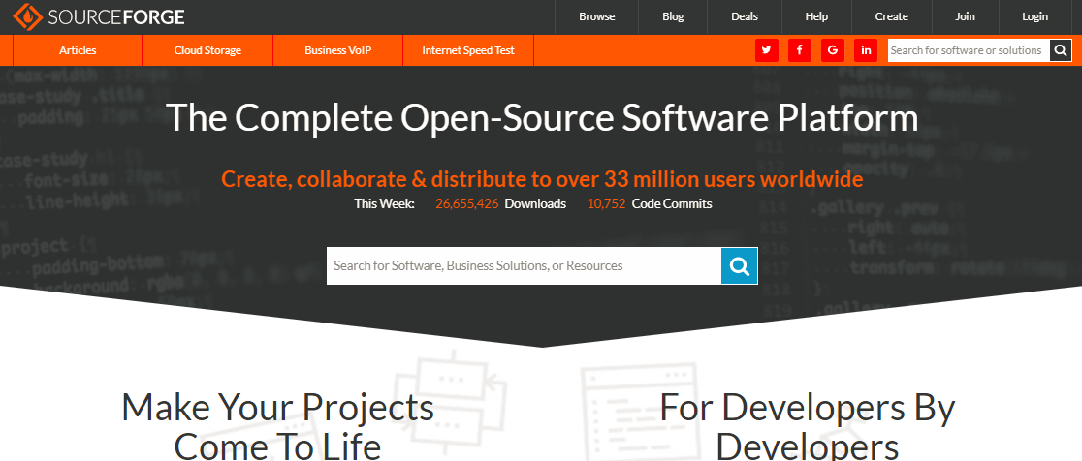


Start Your Open Source Project

Slide 6






Open Source Forum

Slide 7
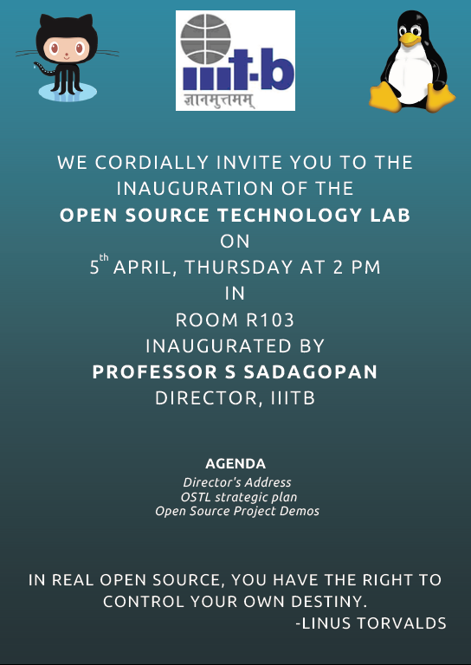
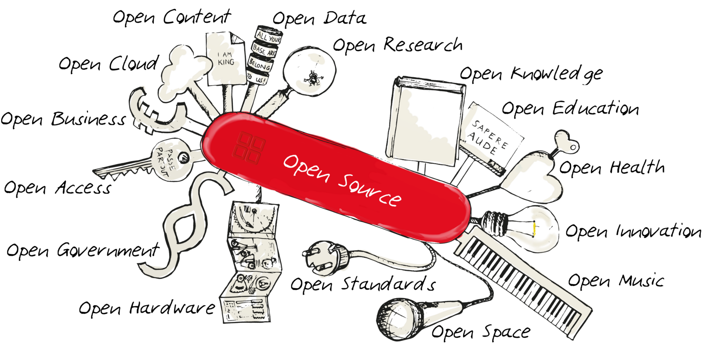
Open Source Technology Lab 2018-19 Report

Slide 8
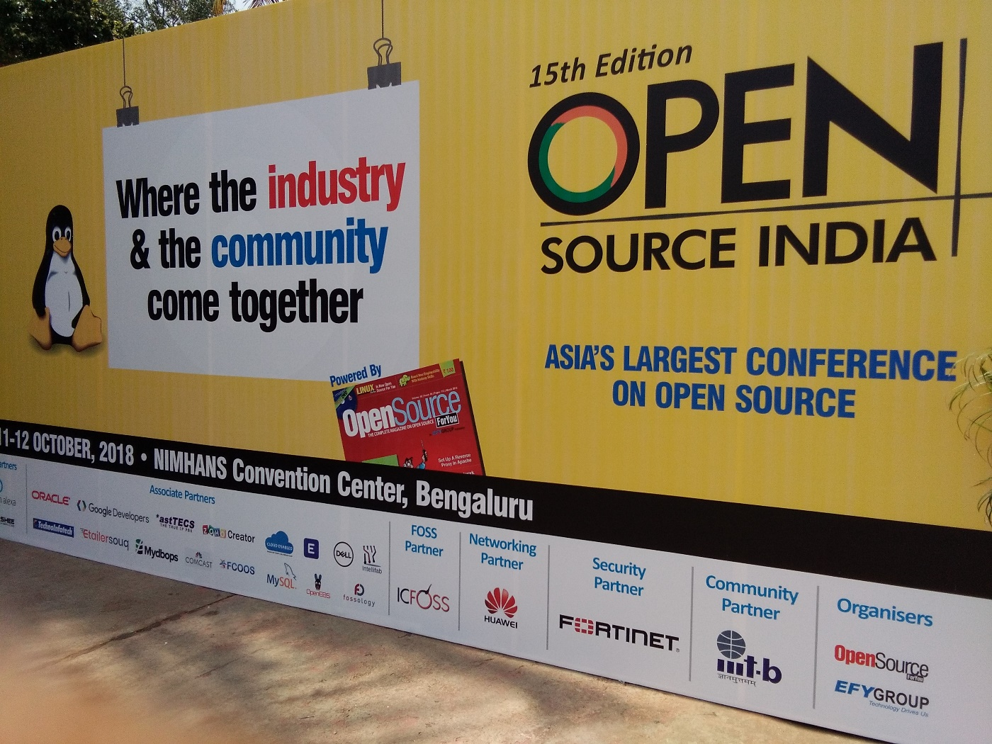
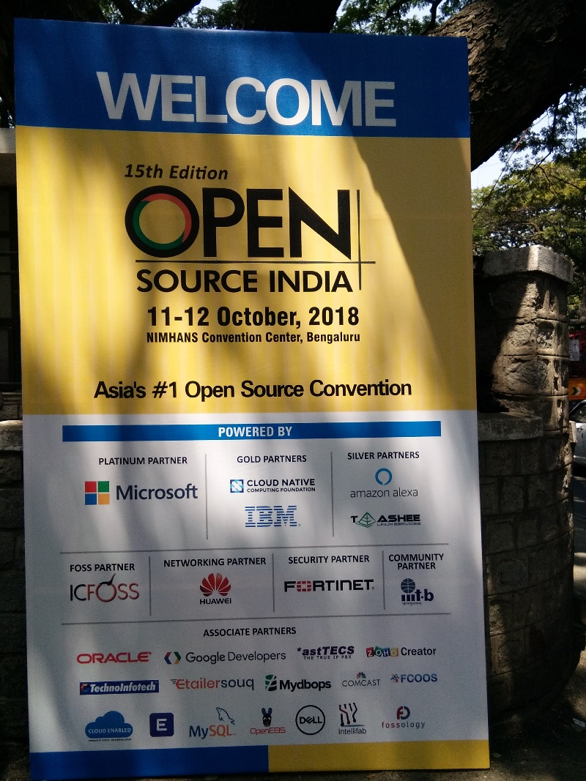
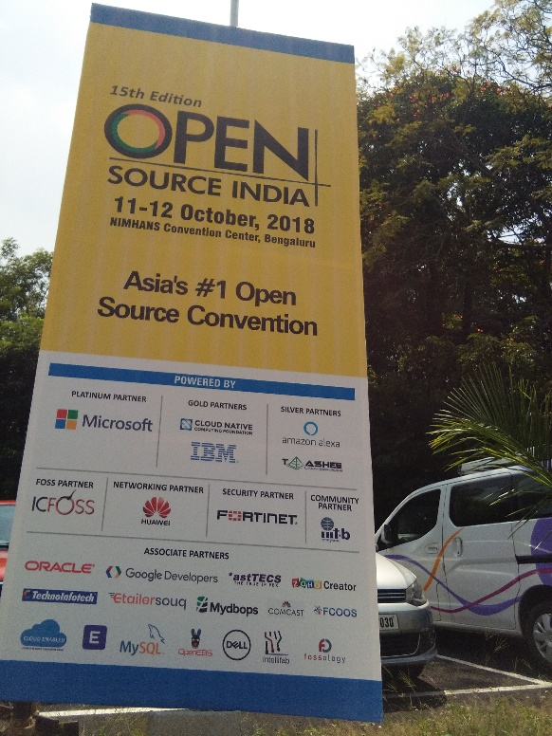
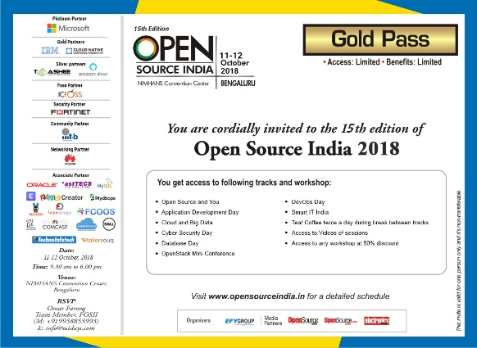
Open Source India 2018
IIITB was proud Community Partner in the Open Source India 2018 event
Thirty five students from our institute attended the conference
Attended Students felt that program was current, very relevant and useful to them
We interacted with various companies who are working with open source software, cloud and DevOps
The Community partnership with Open Source India 2018 event was very useful

Slide 9



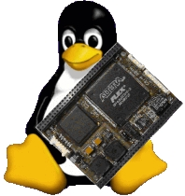




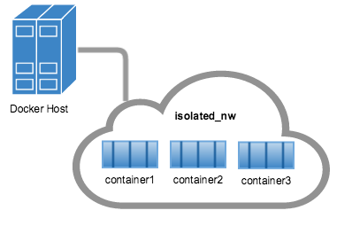



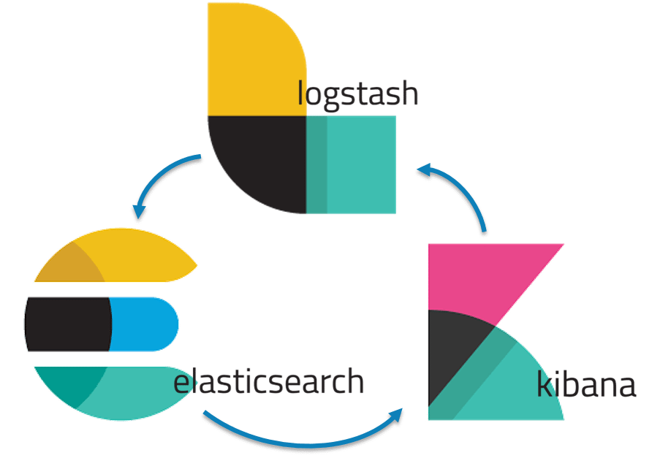
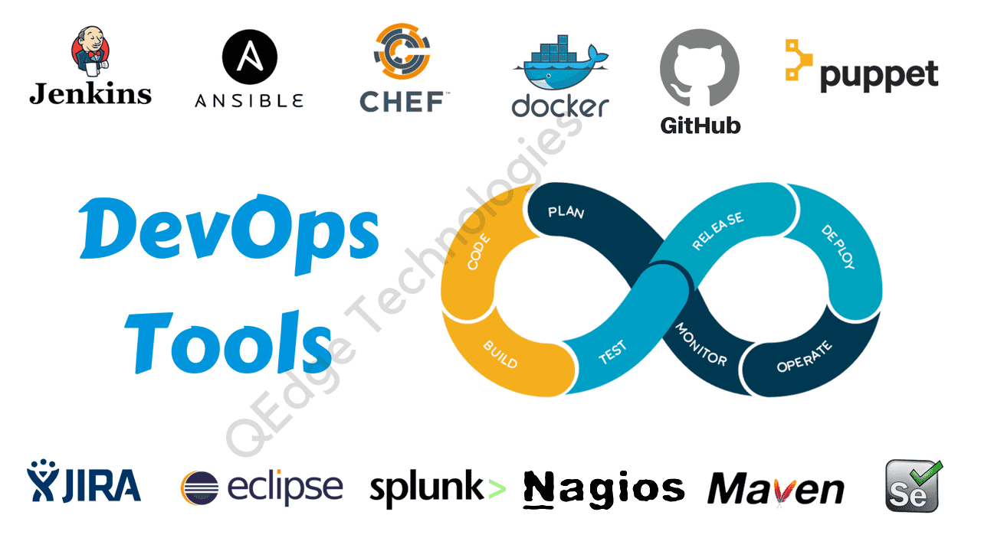



OSS Topics
Carrier Grade Linux
Linux for Embedded and Real Time Systems
Linux Power Management
Container Orchestration
Kubernetes
Network
Private / Public Cloud Setup
Virtual Machine / Container
Lightweight OpenStack
Deployment Automation – Rundeck
Continuous Monitoring – ELK Stack

Slide 10




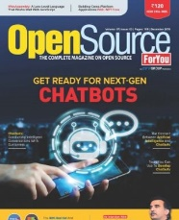
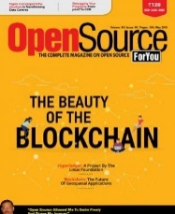


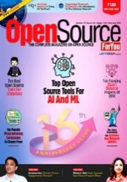



OSS Projects and Contribution
Project Topic: Community Powered digital circuit simulator -https://circuitverse.org/
Source code link: https://github.com/CircuitVerse/CircuitVerse
All time registered users: 3277
Google Analytics - On average 300 visitors per day, 8100 visitors in the last 30 days.
Circuitverse got selected as an Organization for a Google summer of code program 2019.
23 Students have been working on different topics
Communication / Notification Sink
Registration Client Harness
Print and Post System
Resident Portal
5. Data Enrichment Source - CNIE, EC Systems
6. Fingerprint Biometrics Matcher Library
7. Registered Devices Service - L1 Auth Devices
https://mosip.io
Website link: https://adishegde.github.io/media_hub/
Peer to peer file sharing application
Decentralized file sharing over LAN
Student’s contribution was accepted and released in latest version Pharo 7.0 in Mar 2019. (Enhanced CLI)
Student presented his work on Kubernetes at Open Source Summit, Scotland, UK, 23rd October 2018. Organized by Linux Foundation.
OpenShift Project: Selected for the CERN Open Lab summer program 2019 in Geneva. (2 months summer internship)
OSFY
We are working with Prof. Uttam Kumar on hosting a mirror site for the software GrassGIS and R packages.
Notes:
Project Topic: Community Powered digital circuit simulator
Web page link: https://circuitverse.org/
Source code link: https://github.com/CircuitVerse/CircuitVerse
All time registered users: 3277
Google Analytics - On average 300 visitors per day, 8100 visitors in the last 30 days.
Circuitverse got selected as an Organization for a Google summer of code program 2019.
Pharo is an open source project which works on pure object oriented programming. It is a fork of the legendary language small talk.
Vineet, 5th year iMTech student’s contribution has accepted and released in latest version Pharo 7.0 in Mar 2019.
Since he has expertise in Docker and Kubernetes, he got selected for the CERN Open Lab summer program 2019 in Geneva. All over the world they selected only 40 students including Vineet.
(CERN, the European Organization for Nuclear Research, is one of the world's largest and most respected centers for scientific research.)
MediaHub is a peer to peer file sharing application by Aditya (3rd year iMTech)

Slide 11
List of Publications https://opensourceforu.com/author/b-thangaraju/
No | Name | Topic | Date | link | No. of Viewed
1 | Deepika and Prashanthi | A Quantitative Analysis of the Real-time Capabilities of Linux with PREEMPT_RT | April 2018 | https://opensourceforu.com/2018/05/a-quantitative-analysis-of-the-real-time-capabilities-of-linux-with-preempt_rt/ | 2894
2 | Vineet Rajula | Container Orchestration with Kubernetes | May 2018 | https://opensourceforu.com/2018/06/container-orchestration-with-kubernetes/ | 3252
3 | Harika and Shreyak | The Intricacies of Docker Networking | June 2018 | https://opensourceforu.com/2018/07/the-intricacies-of-docker-networking/ | 3918
4 | Vaibhav Aggarwal | How the Blockchain Can Add Transparency to Healthcare | January 2019 | https://opensourceforu.com/2019/02/how-the-blockchain-can-add-transparency-to-healthcare/ | 1801
5 | Sravya Goli | Web Security | January 2019 | https://opensourceforu.com/2019/02/is-your-website-secure/ | 1889
6 | Poonam | How to Avoid Priority Inversion and Enable Priority Inheritance in Linux Kernel Programming | February 2019 | https://opensourceforu.com/2019/04/how-to-avoid-priority-inversion-and-enable-priority-inheritance-in-linux-kernel-programming/ | 1539
7 | Sravya Goli | How Man in the Middle Attacks Cause Damage | March 2019 | https://opensourceforu.com/2019/04/how-man-in-the-middle-attacks-cause-damage/ | 1462
8 | Vaibhav Aggarwal | Blockchain Development Made Easy with Open Source Tools | April 2019 | https://opensourceforu.com/2019/06/blockchain-development-made-easy-with-open-source-tools/ | 1224
9 | Dhanashree | Get Rid of Priority Inversion with PI-Futex | April 2019 | https://opensourceforu.com/2019/06/get-rid-of-priority-inversion-with-pi-futex/ | 1080

Slide 12


